Slide 1
Principal Orientation (K-8)
Notes:
2021-2022

Slide 2
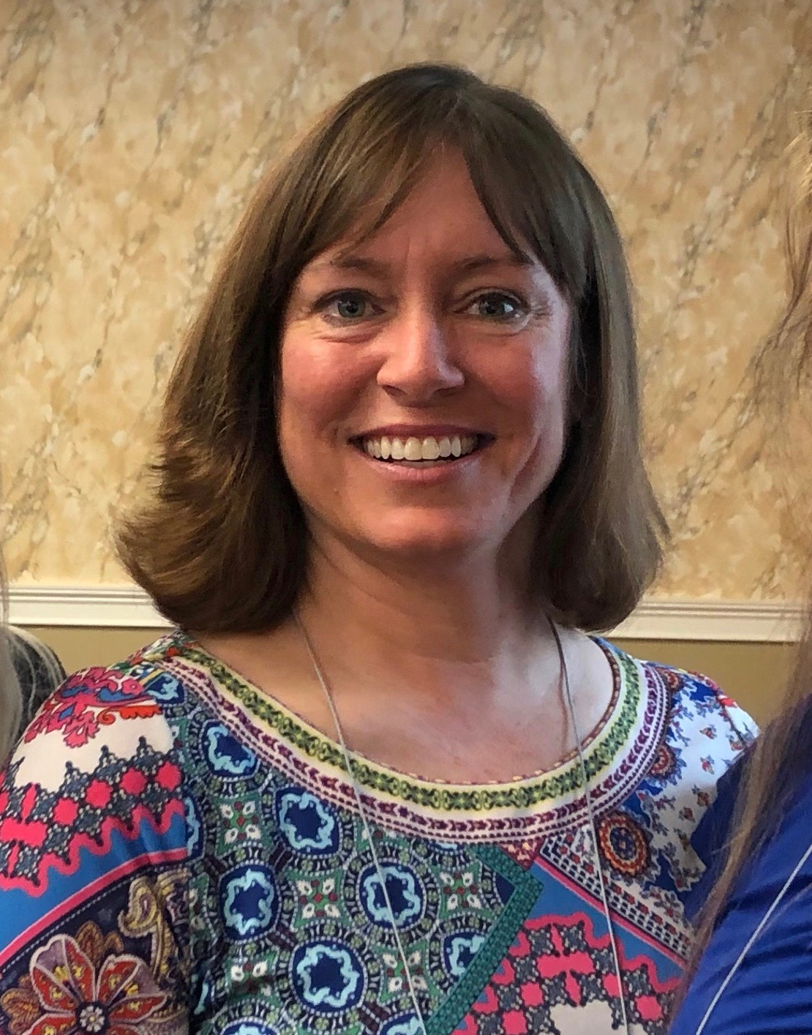
SFFC Foundation
The SFFC Foundation is a nonprofit organization based in Nashville, TN. Our current initiatives include the PFE Scholarship and Nourish Grants for individuals/families.
Administration Team
Ashley Beisiegel Jackie Downs
K-8 Program Officer 9-12 Program Officer
Office Number: (615) 675-0450

Slide 3
Origin Video

Slide 4
Your Commitments
Work with your coordinator to complete the PFE Scholarship Application.
Identify committed PFE team members and be familiar with job description for each.
Facilitate effective communication among team members.
Share the story of PFE in your local communities and churches.

Slide 5
Team Roles
One person may assume multiple roles. Make sure they are not overwhelmed. Each team member must review their respective training(s) by your start date.
Be aware of continuity and cessation training. If a team member changes in the middle of the year:
Inform PFE Administration and provide your new member’s name, phone number, email, position, and relationship with the school.
Instruct the new team member to complete his/her respective training, as well as encourage in-person training from the previous job holder.

Slide 6
Staffing Your Team
Coordinator
Should not be the principal, teaching principal, or a teacher (due to heavy load)
Who? Parent volunteer, school secretary, teacher’s aide, board member, etc. Someone who can commit time and is passionate about PFE.
Time commitment? Up to a few hours per week, depending on participation numbers.
Mentor Liaison
Who? A pastor or visiting elder (someone who enjoys visiting with people) from a constituent church
Time commitment? Up to a few hours per month

Slide 7
Treasurer
Who? School treasurer or business manager. Whoever manages your students’ tuition accounts.
Time commitment? 1-2 hours per month.
Fundraiser
Who? A board member, school administrators, or an individual from your school’s development office.
Time commitment? Varies according to experience and existing fundraisers.

Slide 8
Student Selection
Participant slots are based on school enrollment at the end of the previous year.
Schools with enrollment of 30 or fewer are allowed up to 50% of enrollment.
Schools with enrollment of 31 or more are allowed up to 20% of enrollment.
This scholarship is for:
Students and parents who are passionate about serving others.
Students who would benefit from a positive intergenerational connection.
PFE is not a needs-based scholarship.
Primary selection criteria should be a passion to serve.

Slide 9
Student/Parent Orientation
Your team is required to hold a yearly orientation that each participant (and PFE parent) must attend.
Orientation:
Does not count as scholarship time and will not be paid.
Must take place before students commence their visits for the year.
PowerPoint and student packet are provided
Tip: Have students create their account on the reporting website during orientation.

Slide 10
Scholarship Allocation
It is up to your school to determine when to apply the tuition assistance.
PFE scholarship money may only be applied to students’ tuition accounts.
PFE scholarship money is not to go towards expenses such as books, classroom needs, field trips, uniforms, etc.
If a student leaves your school with a PFE credit to his/her account, that money may not be paid out in cash. The extra tuition assistance may be put toward your 30% fundraising.

Slide 11
Safety
In order to keep each student/mentor safe while visiting:
A parent or legal guardian (K-8 students) is required to accompany and supervise each visit. They are responsible for their child’s safety.
Sitting in the car during a visit is not adequate supervision (unless the visit occurs outdoors/within sight)
Visits that occur without parental supervision will be declined.
Make sure you are complying with any of your conference’s policies for student safety, including background checks, if applicable.

Slide 12
Impact Video

